Slide 1
Scientific Research
Dirk Riehle, Univ. Erlangen
NYT B02
Licensed under CC BY 4.0 International

Slide 2
Agenda
Research questions
The research process
Research methodologies
Research methods and practices
Research quality criteria

Slide 3
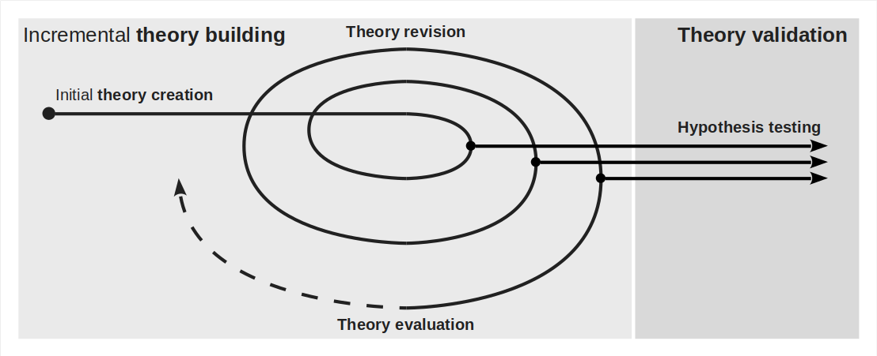
Theory Building and Validation (Recap)

Slide 4
1. Research Questions

Slide 5
Research Question and Hypothesis
A research question is
The question of interest to be answered by research
A research hypothesis is
A research question that can only be answered with yes or no, true or false
Research questions should answerable and non-trivial
The answer can be big (a whole theory) or small (yes/no)

Slide 6
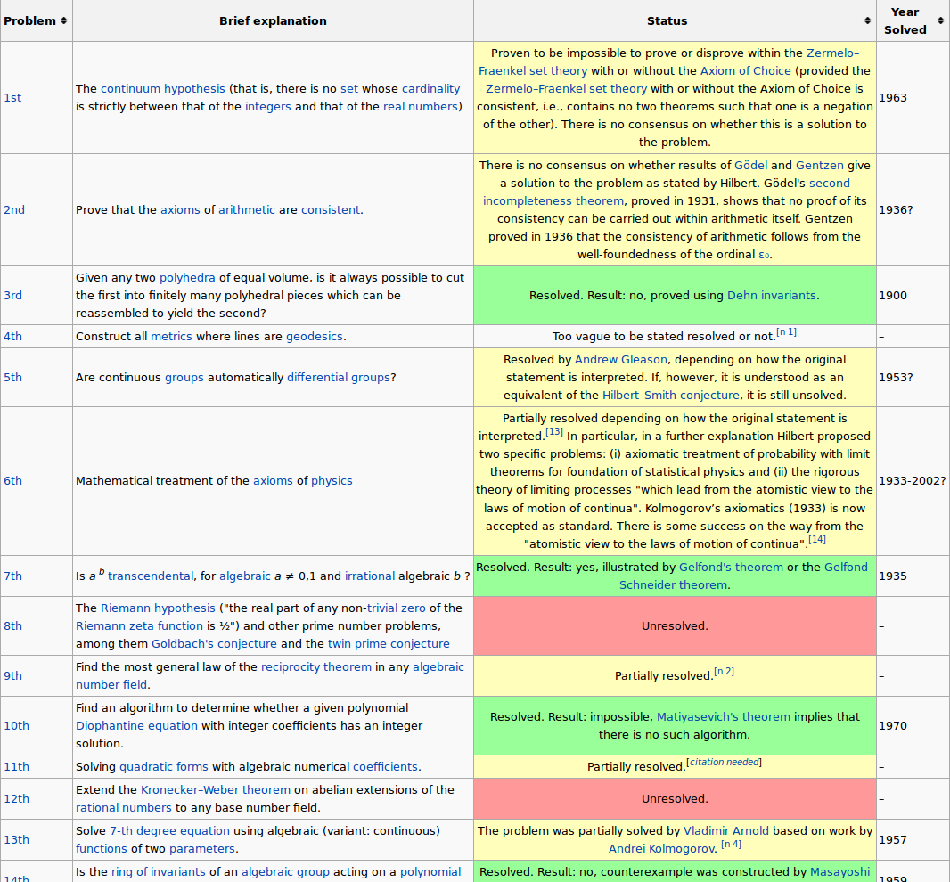
Hilbert’s 23 Problems [1]
[1] See https://en.wikipedia.org/wiki/Hilbert%27s_problems

Slide 7
Example Research Questions [1]
 | People | Practices | Artifacts
Method of Analysis | How to measure communication effectiveness? | How to track bug fixes in software development? | How to measure effort spent on a piece code?
Method of Development | How to distribute roles in an agile development team? | How to perform code reviews? | How does agile development ensure high quality?
Evaluation of Instance | What skills of Linus Torvalds are key for the Linux kernel? | What are some new types of code refactorings? | How patchy is the Apache web server?
Generalization or Characterization | What does it take to be a good programmer? | What's common to all open source processes? | How does the the open source commit distribution look like?
Feasibility or Exploration | Do energy drinks help programmers write code faster? | Is “Test First” a viable principle? | What could a power plant security hole do to safety?
[1] Derived from Shaw (2003): Writing good software engineering research papers.

Slide 8
Related Work
Related work is
(All) existing scientific work related to your research question
Related means
Someone else worked on the same or similar research question
The work takes an alternative or contradicting starting point
Your proposed work requires and builds on this (related) work
Searching for and identifying
Related work is likely to change your research question
A literature review is a common form of searching for related work

Slide 9
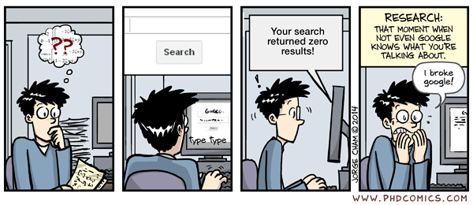
One Stopping Criterion [1]
[1] See https://phdcomics.com

Slide 10
Research Result
A scientific research result is
Any piece of information resulting from scientific research
Where scientific research is work following proper methods
The answer to a research question is
A scientific result that answers a corresponding research question
A scientific result should be
verifiable,
reproducible, and
independent of the researcher

Slide 11
Paper
A research paper is a (science-idiomatic) term for
A research article
It may or may not yet have passed peer review

Slide 12
Contribution
A contribution is a (science-idiomatic) term for
A publishable / published research result
To be found in the contributions section of a research paper

Slide 13
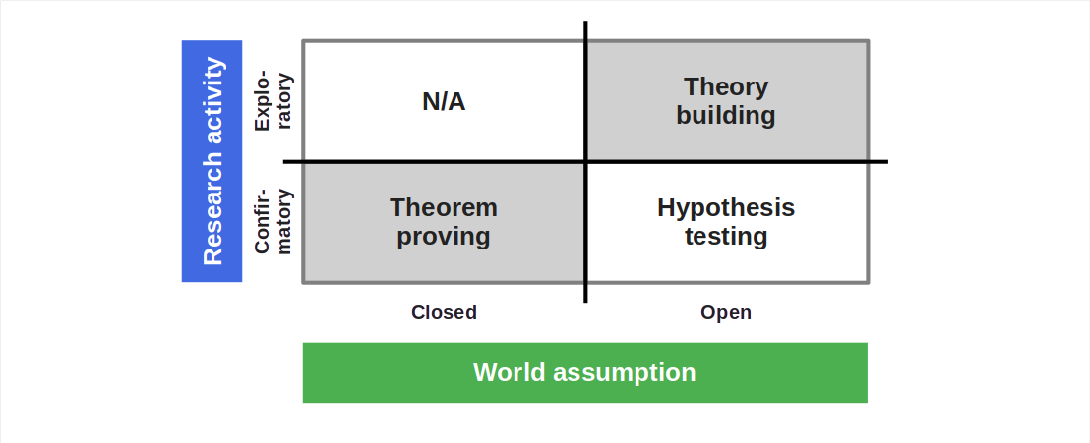
Open vs. Closed World Assumption

Slide 14
Is This So? Why / Why Not?
“In theory, practice and theory are the same. In practice, they are not.” [1]
[1] Attributed to Albert Einstein

Slide 15
2. The Research Process

Slide 16
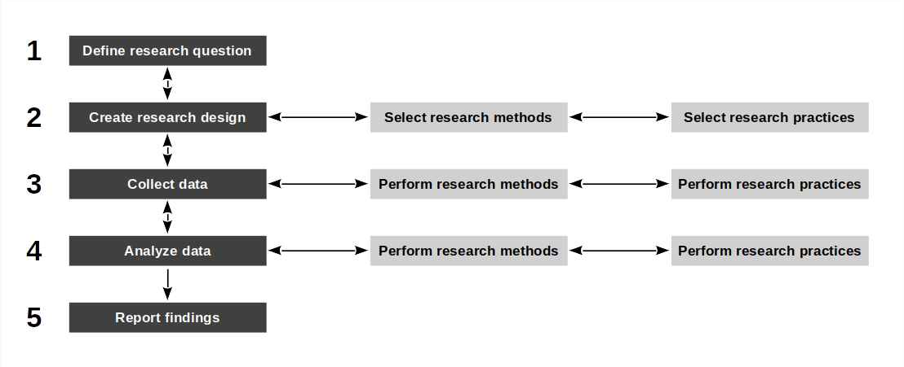
Generic (Idealized) Research Process

Slide 17
Research Methodology vs. Design vs. Method vs. Practice
A research methodology is
A start-to-finish framework for performing theory building
A research design is
A process description for answering a research question
A research method is
A method for answering a type of research question
A research practice is
A way of doing something with a defined outcome

Slide 18
Research Projects
A research project
Is a project that contributes to scientific progress
Typically answers a (large or small) question
As a project has a start and an end date
Research projects can be built from parts
A principal investigator may define a whole project
Graduate researchers may work on subprojects
Thesis students may work on one question

Slide 19
(Almost) All Research is Iterative
The scientific process is
Iterative and incremental in how it builds out theory
Its results presentation should
Follow a linear logical structure usually corresponding to the research design
Beginners mistake when writing a thesis
Focusing your process steps, not your results

Slide 20
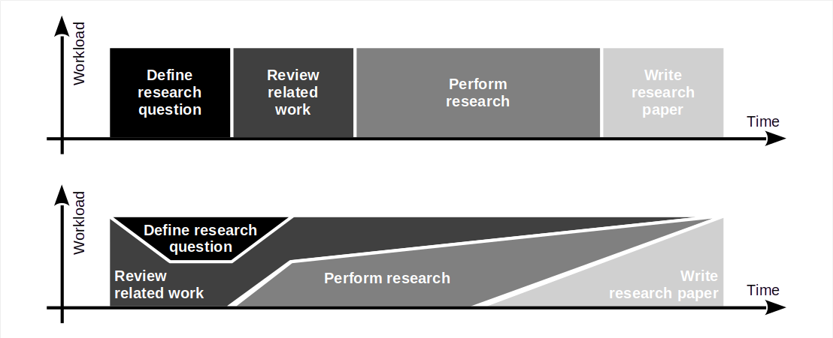
How Time is Spent in Research

Slide 21
Research Protocol and Process Tracking
Document your research design and proposed process before you start
Register this so-called research protocol with independent resource
Track data, process, and progress of actual work in lab book (audit trail)
Discuss plan vs. execution in discussion and limitations section

Slide 22
3. Research Methodologies

Slide 23
Research Methodology
A research methodology is a
Start-to-finish framework for theory building
Constraint system for research designs
Pattern for research designs

Slide 24
Example Research Methodology
The qualitative survey [1] according to Jansen (2010)
Write research protocol [3]
Build sampling model [2]
Sample for theory building [2]
Perform interviews [2]
Analyze transcriptions [2]
Determine saturation [3]
Iterate or conclude
[1] A.k.a. interview study (when restricted to interviews)
[2] A research method
[3] A research practice

Slide 25
Some (Categories of) Research Methodologies
Systematic survey
Qualitative survey
Action research
Case study research
Grounded theory
Ethnographies

Slide 26
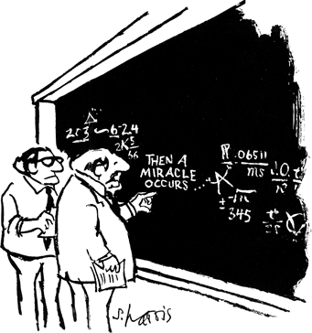
“I think you should be more explicit in step 2” [1]
[1] See http://www.sciencecartoonsplus.com/

Slide 27
Research Design
A research design is
A structured plan to answer a research question
Created by applying a research methodology

Slide 28
Example Research Design Inner Source Challenges
Research question
What are challenges of inner source collaboration in software development?
Possible research approach
Qualitative survey according to Jansen (2010)
Resulting research design
Model units of analysis (companies, employees) of interest
Identify units of analysis using sampling model
Contact and interview experts
Analyze interviews using thematic analysis according to Braun & Clarke (2012)
Determine saturation and iterate if not satisfied

Slide 29

The Marshmallow Experiment [1]
[1] See https://www.youtube.com/watch?v=Yo4WF3cSd9Q

Slide 30
4. Research Methods and Practices

Slide 31
Research Method
A research method is
A prescriptive procedure to answer a research question
Which collects and analyses one set of data
Research method vs. research methodology
A methodology provides a framework while a method provides a prescription
It ain’t a methodology if it ain’t theory building

Slide 32
Example Research Methods
Thematic analysis according to Braun & Clarke (2012)
Controlled experiments according to Wohlin et al. (2012)
Biometric measurements according to Fagerholm & Fritz (2020)

Slide 33
Research Practice
A research practice is a
An established procedure that when employed provides a defined result
That is known to practitioners of science but has not been codified yet
Research practice vs. research method
A research practice may not have a name or formal definition
A research practice may be a prototype of a method

Slide 34
Example Research Practices
Example practices with a name
Forward snowballing (an article search strategy)
Polar sampling (a purposive sampling strategy)
Peer debriefing (a quality assurance practice)
Example practices without a name
How to derive a code name
How to report on a Student’s t-test results
How to codify a theory using best practices handbooks

Slide 35
Research Methods (Expanded)
A research method is
A prescriptive procedure
For collecting and analyzing one type of data
To answer a research question
An established research method has been validated
It has been shown to deliver what it promises
Methods should have their own quality assurance criteria

Slide 36
Two Categories of Research Methods
A qualitative research method is a
Research method that
Collects and analyses qualitative data
Creates theoretical insights
A quantitative research method is a
Research method that
Collects and analyses quantitative data
Lets researchers draw descriptive or statistical conclusions

Slide 37
Qualitative vs. Quantitative Data (Expanded)
Qualitative data is data that
Usually is not numeric
Requires interpretation
Is used in theory building
Denies statistical generalizations
Quantitative data is data that
Usually is numeric (various scales)
Has objective (formal) definition
Is used for theory validation
Serves statistical generalization

Slide 38
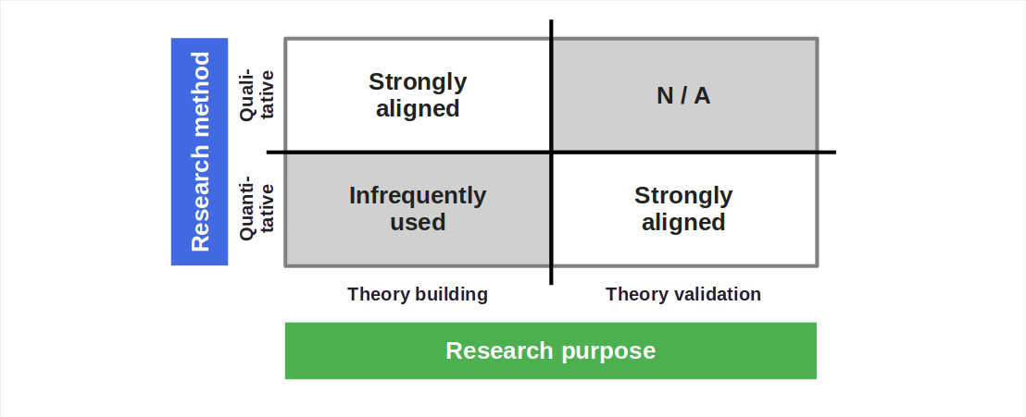
Qualitative / Quantitative vs. Theory Building / Validation

Slide 39
“Soft” vs. “Hard”
Qualitative research
Deals with qualitative data
Feedback takes time
Feedback is not binary
Quantitative research
Deals with quantitative data
Feedback is fast
Feedback is precise / binary

Slide 40
Should You Invent Your Own Methods?
Never invent your own methods
Rather use established research methods
There will always be exceptions, but think hard if your situation is one

Slide 41
5. Research Quality Criteria

Slide 42
Quality Criteria for Research Methods [1]
Intuition | Qualitative research | Quantitative research
Truth value | Credibility | Internal validity
Applicability | Transferability | External validity
Consistency | Dependability | Reliability
Neutrality | Confirmability | Objectivity
[1] See Guba & Lincoln (1982) for a discussion

Slide 43
Truth Value (Category)
Truth value (framed as question)
To what degree can we establish confidence in the “truth” of findings?
Credibility (naturalism)
The degree of confidence in the truth of the findings
Internal validity (rationalism)
The degree of confidence in a cause and effect relationship

Slide 44
Applicability (Category)
Applicability (framed as question)
To what degree can we determine the applicability of findings in other contexts?
Transferability (naturalism)
The degree to which findings can be transferred to another context
External validity (rationalism)
The degree to which findings can be generalized beyond the study

Slide 45
Consistency (Category)
Consistency (framed as question)
To which degree can the findings be consistently repeated?
Dependability (naturalism)
The degree to which findings are stable over time
Reliability (rationalism)
The degree to which findings can be recreated under the same conditions

Slide 46
Neutrality (Category)
Neutrality (framed as question)
To which degree are the findings independent of the researcher?
Confirmability (naturalism)
The degree to which the findings can be confirmed by other researchers
Objectivity (rationalism)
The degree to which the findings can be repeated by other researchers

Slide 47
Summary
Research questions
The research process
Research methodologies
Research methods and practices
Research quality criteria

Slide 48
Thank you! Any questions?
dirk.riehle@fau.de – https://oss.cs.fau.de
dirk@riehle.org – https://dirkriehle.com – @dirkriehle

Slide 49
Legal Notices
License
Licensed under the CC BY 4.0 International license
Copyright
© 2012, 2023 Dirk Riehle, some rights reserved

